Slide 1
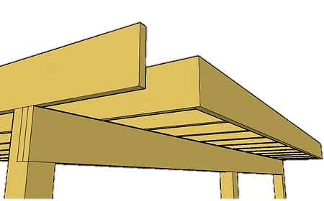
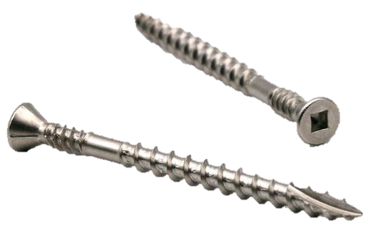
KWILA HARDWOOD DECKING INSTALLATION GUIDE
At bbi Wood Products we supply Kwila, Vitex, and Garapa hardwood decking. When installing hardwood decking it is important to follow the below guidelines to ensure a quality and long lasting finish.
Handling and Storage
Kwila Hardwood decking should be kept dry before installation, storage of decking on site should be in a cool, dry place, out of direct sunlight and elevated on bearers approx. 100mm off the ground to allow for air flow.
Planning
Before undertaking any construction work you must consult with your local authority to check than any construction requirements are met and to determine if a Building Consent is required. A qualified tradesman should be consulted where expert services may be required.
19mm decking should be installed at maximum 450mm joist centres, 32mm and above should be installed at maximum 600mm joist centres. To ensure proper ventilation, the deck should have at least 450mm clearance from the ground.
Preparation
Check all boards for defects that may require docking out and sort the timber lengths to optimise usage. bbi Wood Products recommends a minimum one coat* of suitable exterior timber decking coating or oil to be applied to all four sides plus cut ends of the decking prior to installation to minimize the effects of cupping and checking.
Fastenings
bbi Wood Products recommend the use of 10g x 65mm 316 Stainless Steel Decking Screws for both 90 x 19mm and 140 x 19mm decking and pilot holes must be drilled. Fixings should be located 15mm in from the edge of the board for 19mm decking and 20mm in from the edge for 24/25mm decking. Fixings should be staggered across the joists to help prevent splitting. Joins must be placed over a joist, decking should be cut square and butted together with a 2-3mm chamfer of the end of each board to mask any unevenness in height. Fixings should be 20mm from the join and angled toward the joist. Screw manufacturers guidelines must be followed to ensure correct screw installation for optimal hold.
Maintenance
Clean your deck annually using a light detergent that contains an anti-fungal agent, re coat* once clean and dry with a suitable exterior timber decking coating or oil. Removing any items that will trap water underneath them (furniture, pot plants, etc.) for the duration of winter will help keep your deck looking great.
Expansion Gaps
Expansion gaps are essential for many reasons, the two most paramount are: to provide ventilation to the decking and to overcome the timbers natural tendency to shrink and swell according to the amount of moisture in the immediate environment.
Three factors must be considered in determining the gap between boards. Firstly the moisture content, decking can be supplied in a range of moisture contents from near green to kiln dried. A kiln dried product will swell whereas a green or air dried product will shrink. The species is also a factor, Kwila is very stable so will not shrink or swell a lot, however other species like Jarrah, Salinga, Massa, Greenheart, Vitex, and others will shrink and swell a lot. The final consideration is the board size , wider boards will shrink/swell more than narrow boards and are more susceptible to cupping so require a larger expansion gap.
 | 90 mm Wide |  | 140 mm Wide
Timber species | Green / Shipping Dry | Air/Kiln Dried | Green / Shipping Dry | Air/Kiln Dried
Kwila | 3 mm | 4 mm | Do not use | 6 mm
Disclaimer
bbi Hardwood Decking is manufactured with care and inspected to ensure quality. bbi Hardwood Decking is a natural wood product and some degree of variation in weight, density, colour, grain, and performance is to be expected. Care must be taken during installation and maintenance to allow for movement. Some movement, swelling, and checking are normal occurrences in natural Harwood Decking.
*Please follow coating manufacturers guidelines for coating product to ensure correct application.

